Slide 1
Comparison of Usability Metrics: A Case Study on
IRCTC
Name: V K S Sandeep ID: 201901286

Slide 2
Table of Contents
Overview
Objective
Process
Target Audience
Usability evaluation
Results of IRCTC application
Design and development
Results of prototype
Comparison of results

Slide 3
Overview
The study aims to compare the usability metrics of the IRCTC mobile application before and after the introduction of new features and updates. The study analyzes three usability metrics, namely efficiency, effectiveness, and user satisfaction. The study is conducted on a sample of users from different age groups and gender to understand the impact of these variables on usability. The study presents a detailed analysis of the results obtained and provides recommendations for improving the usability of the IRCTC mobile application

Slide 4
Project objective
The paper’s primary objective is to improve the usability of the IRCTC application by using the three usability metrics which we have chosen i.e., Efficiency, effectiveness, and User Satisfaction, while redesigning it.

Slide 5
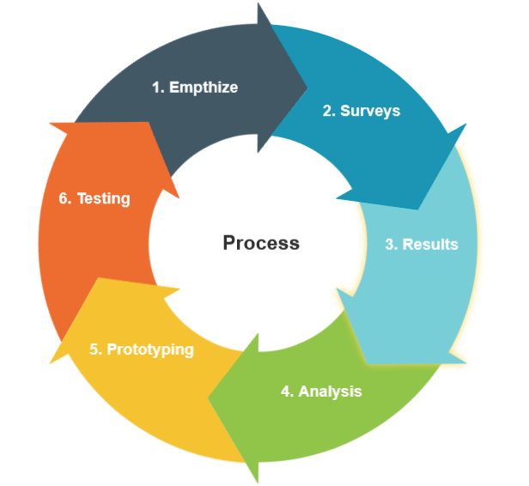
Process

Slide 6
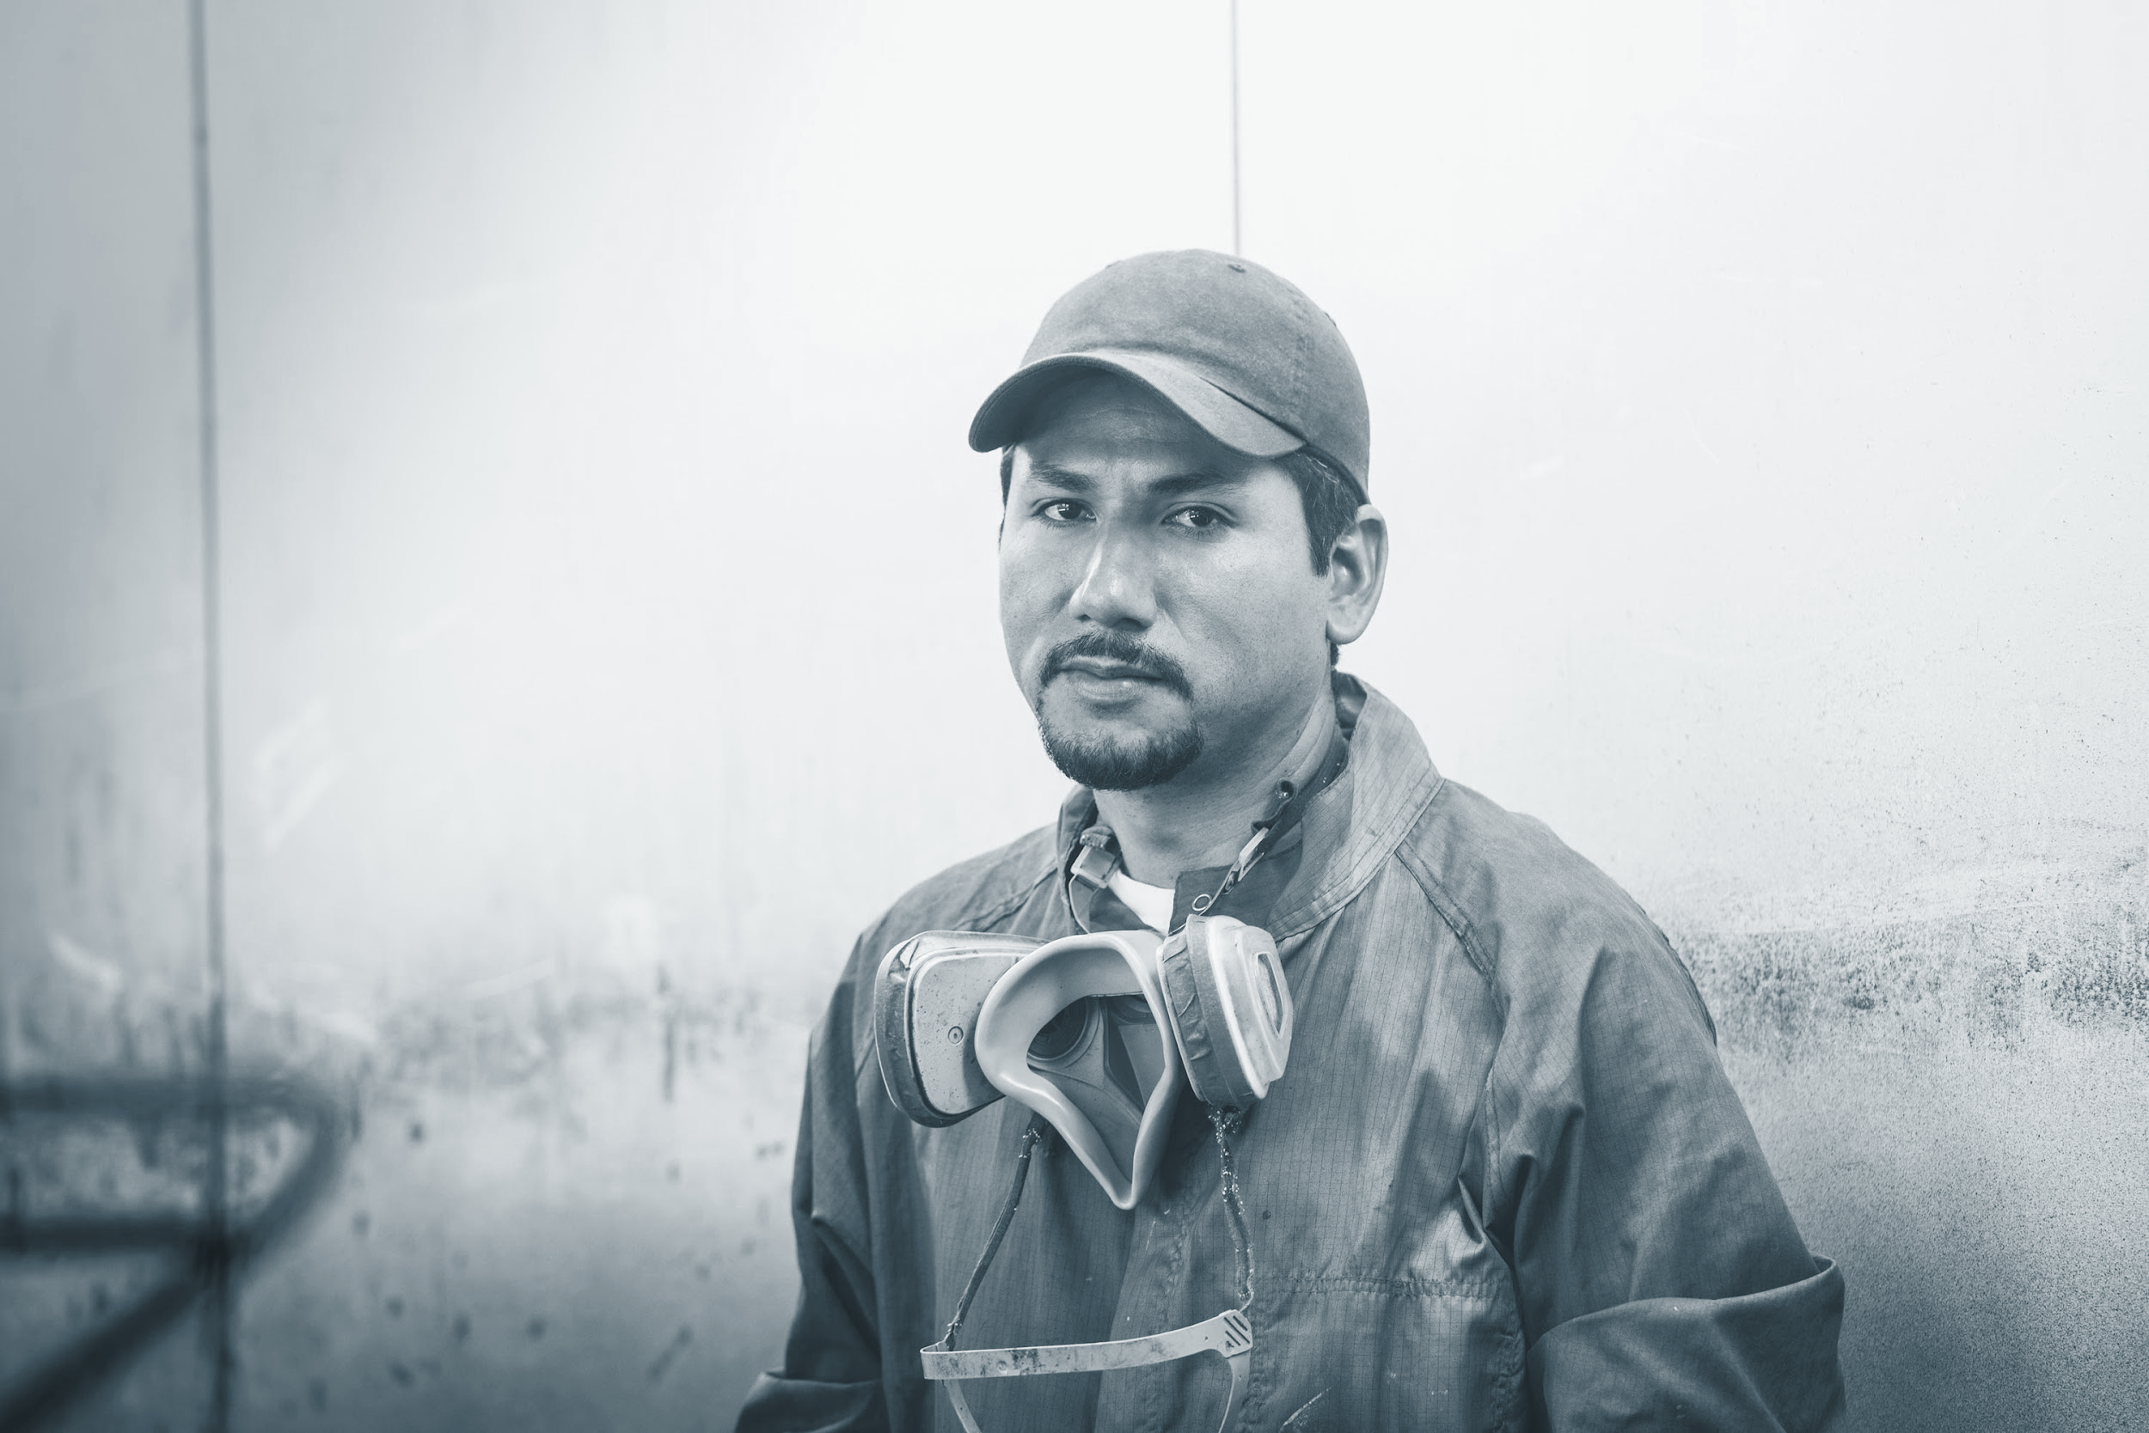


Target audience
The target audience includes people of different ages, genders, and technical skills. The survey can also target regular travelers and first-time users who may have difficulty using the app. The goal is to get feedback from the surveys by as many users to find common problems and improve the app's usability.

Slide 7
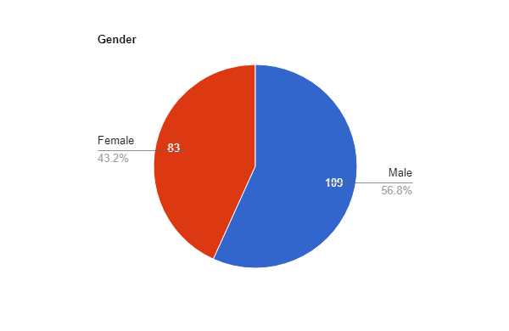
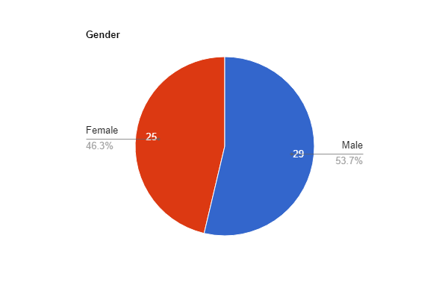
Gender
Online survey
In person interview
Online Survey
In person interview

Slide 8
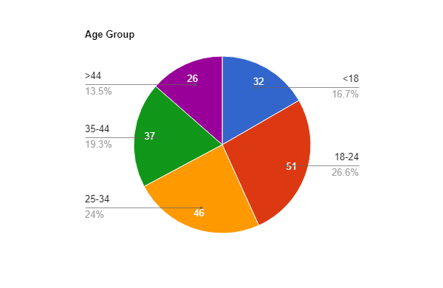
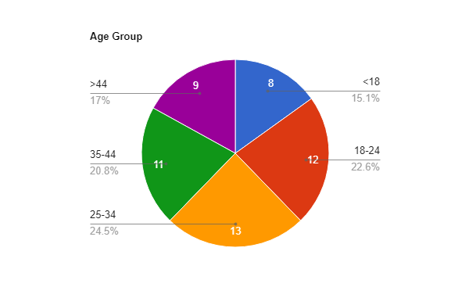
Age Group
Online Survey
In person interview

Slide 9
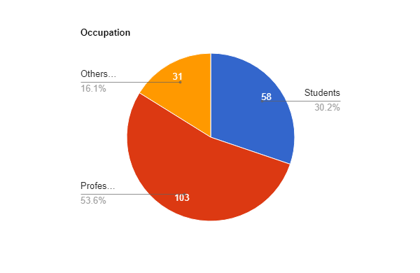
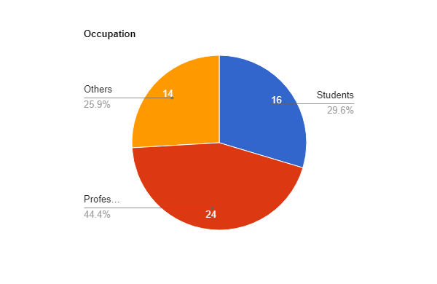
Occupation
Online Survey
In person interview

Slide 10
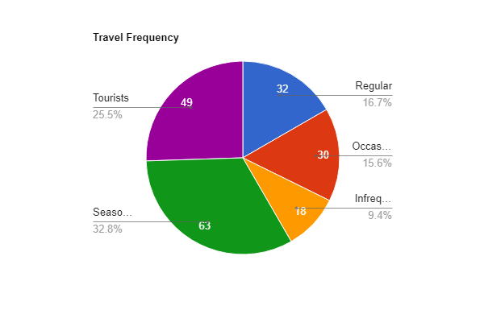
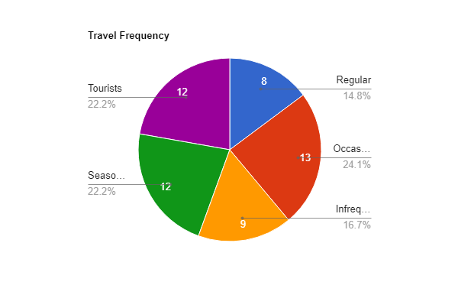
Travel Frequency
Online Survey
In person interview

Slide 11
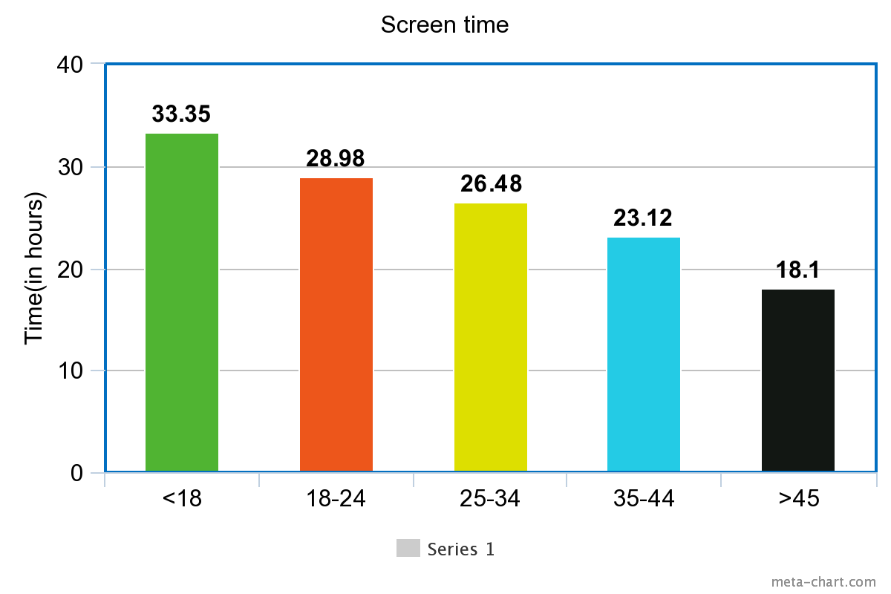
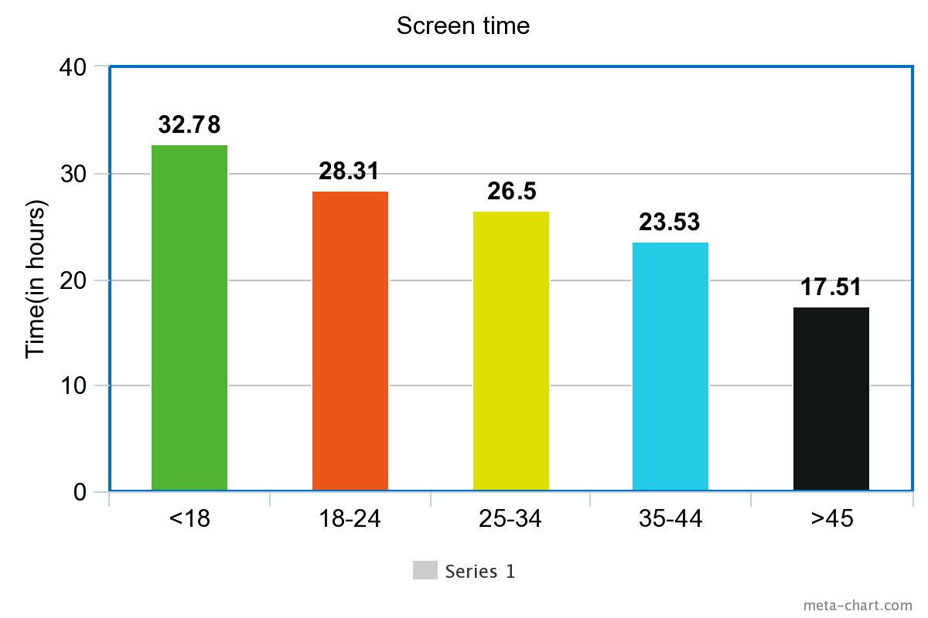
Screen time
Online Survey
In person interview

Slide 12
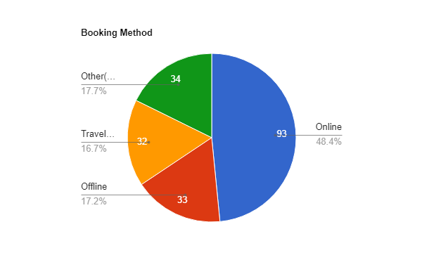
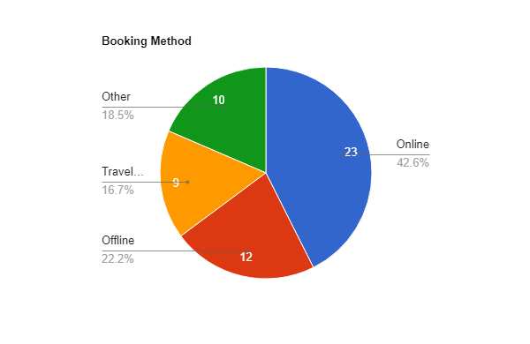
Booking method
Online Survey
In person interview

Slide 13
Usability Evaluation

Slide 14


Online Survey
In person interview

Slide 15
User Persona-A user persona is a fictional character representing a particular type of user for a product or service.
Goals:
To book train tickets for a group of 10 people traveling together
To ensure that everyone in the group is seated together during the journey
To ensure that everyone in the group is seated together during the journey
To make the booking process as smooth and hassle-free as possible
Challenges:
Finding available seats for a group of 10 people can be difficult, especially during peak travel seasons
Coordinating with everyone in the group to ensure that they all arrive at the station on time and board the train together
Understanding the different train fare options and choosing the best one for the group
Dealing with any last-minute changes or cancellations

Slide 16
Behaviors:
Rajesh is comfortable using technology and is familiar with online booking systems
He prefers to do things himself rather than relying on a travel agent
He is willing to spend time researching and comparing different options to get the best deal
He communicates regularly with the members of the group to keep everyone informed and on track
Needs:
A user-friendly booking system that can handle group bookings with ease
Clear information about available seats, fares, and any applicable discounts
The ability to choose seats for the entire group at the time of booking
A reliable customer support system to handle any issues or changes during the booking process

Slide 17
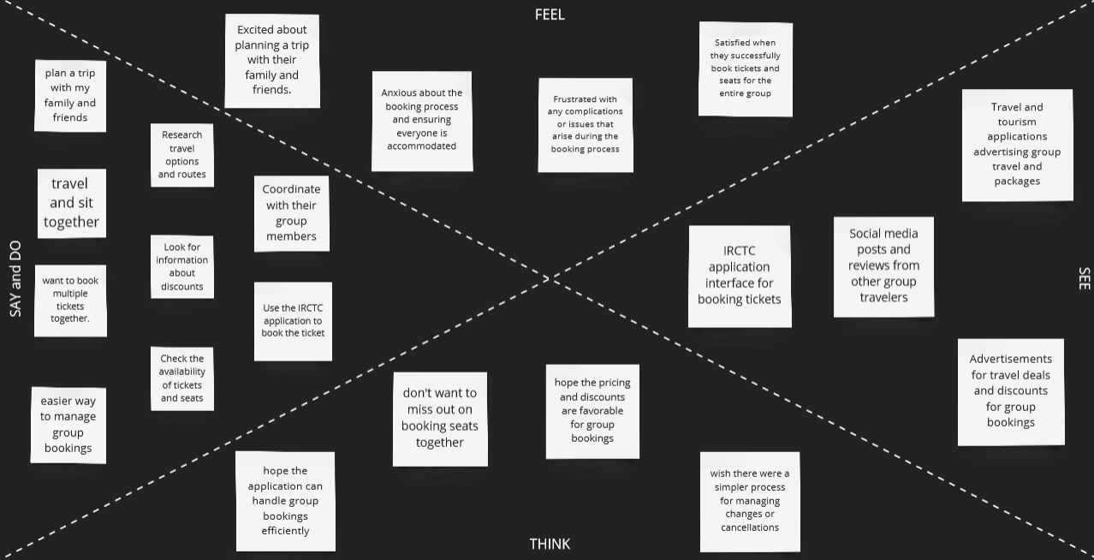
Empathy Mapping-Empathy mapping is a technique used in research to gain a deeper understanding of users’ needs, behaviors, and motivations. It is a tool that helps researchers and designers to develop empathy for the user and to create user-centered solutions

Slide 18
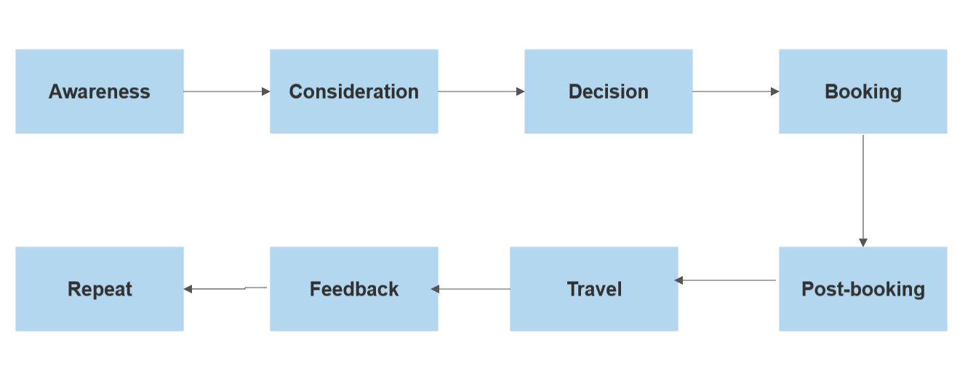
User Journey Map

Slide 19
Results of IRCTC application

Slide 20
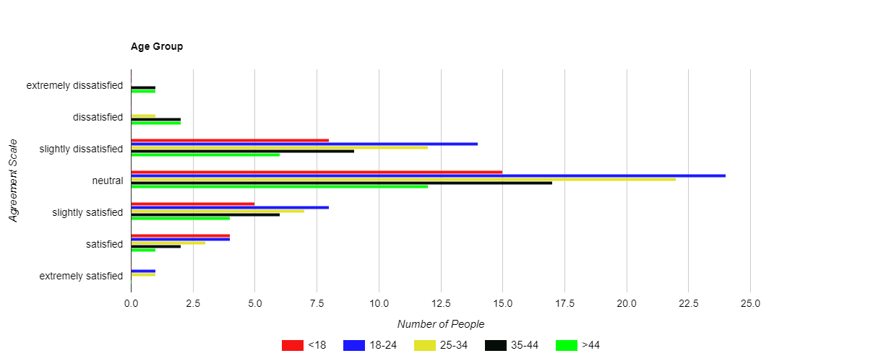
Online survey
Age

Slide 21
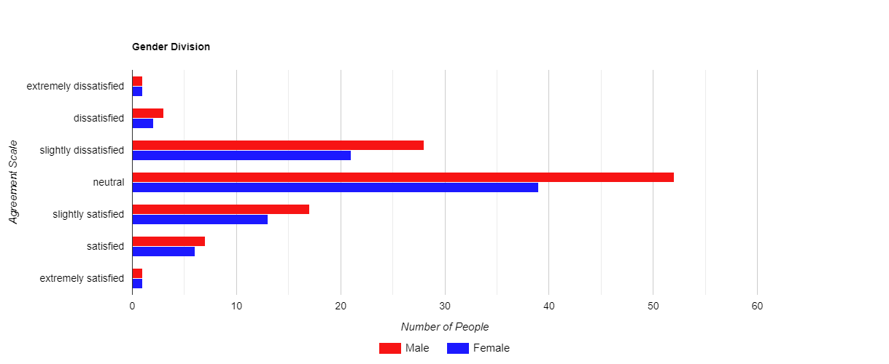
Gender

Slide 22
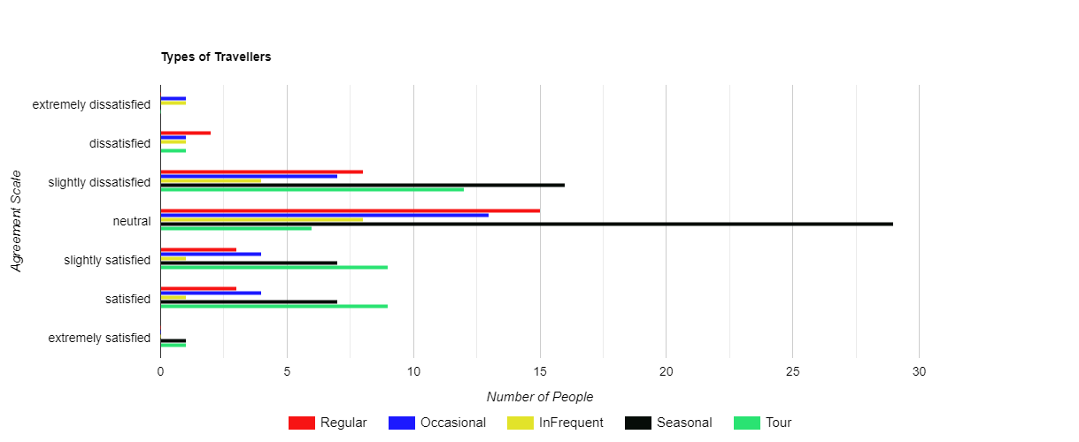
Frequency of Travel

Slide 23
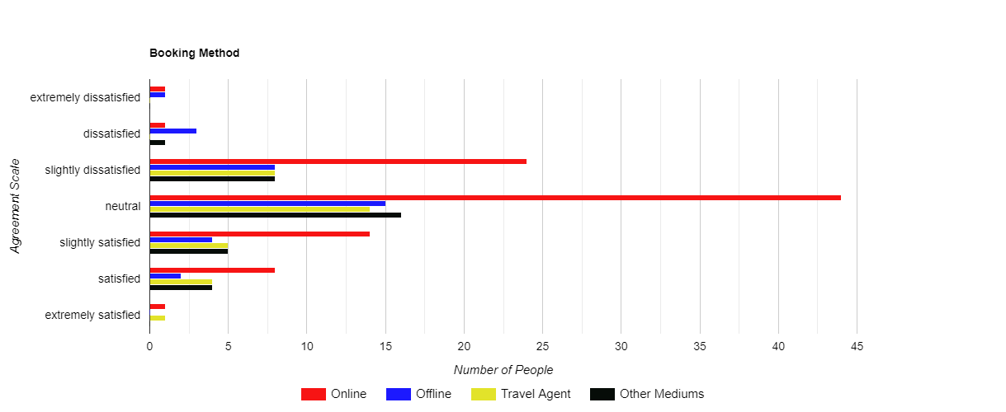
Mode of booking

Slide 24
Three Usability mechanisms

Slide 25
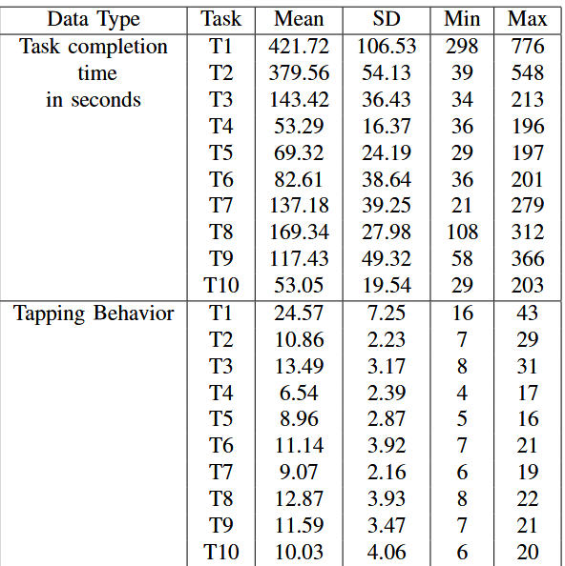
Efficiency

Slide 26
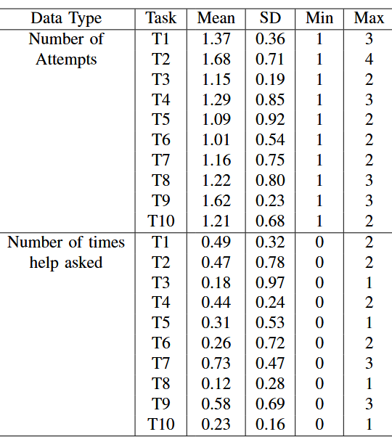
Effectiveness

Slide 27
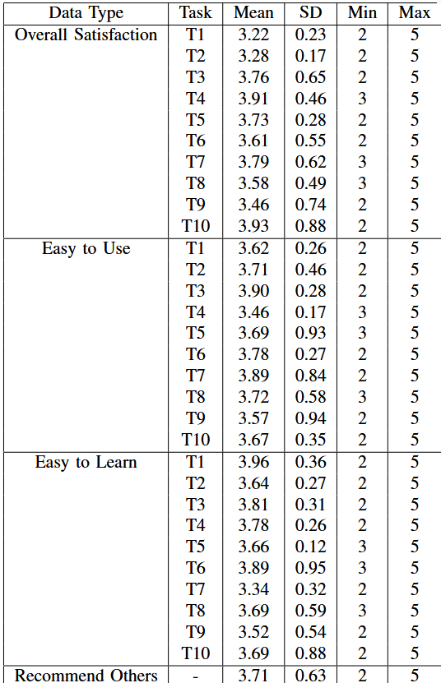
Satisfaction

Slide 28
Issues
The website has too much unnecessary information, leading to customer confusion, and visual clutter makes it difficult to find important information.
Additionally, the options are not well-organized, making it difficult for users to use the information on the screen.
The website layout is unorganized, with many unused spaces in various parts of the app.
New users may have difficulty comprehending the acronyms and technical terminology.
Users often face server-down issues while booking tickets, and they have no way of checking the running status of their train.
The user experience is reportedly very poor, with too many ads making it difficult to book a ticket.
In 2020, the app added a bot named DISHA to find trains, but its slow speed makes it less preferable than manually entering the details.
Users also face challenges with distorted captchas, especially when the letter 'O' and the number zero look alike.

Slide 29
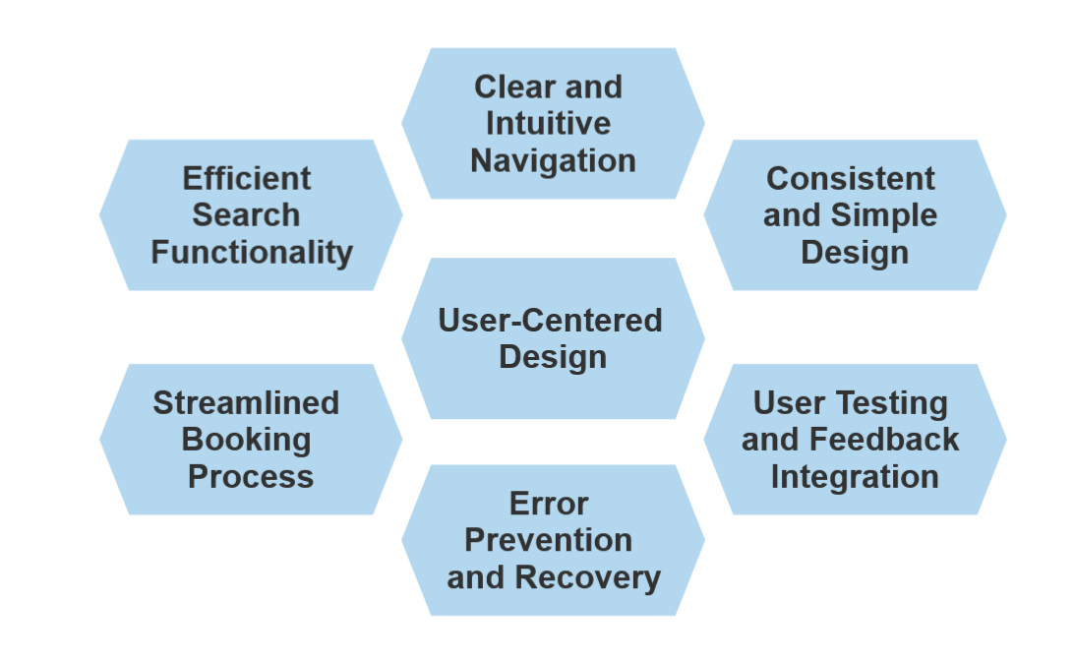
Goals

Slide 30
Design and Development

Slide 31
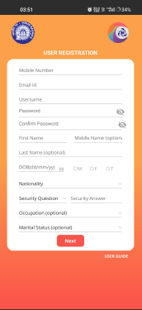
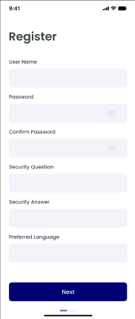
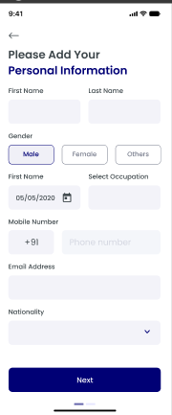
Registering in new User
Original Application
Redesigned Prototype

Slide 32
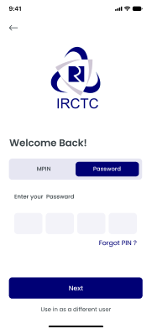
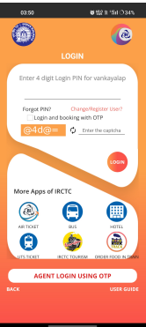
Login Page
Original Application
Redesigned Prototype

Slide 33
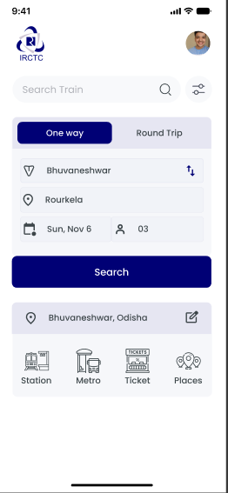
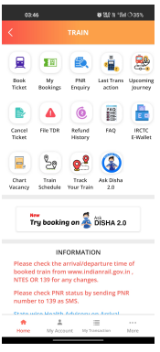
HomePage
Original Application
Redesigned Prototype

Slide 34
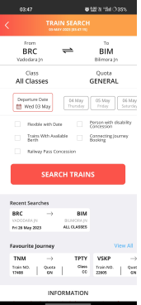
Search Trains
Original Application
Redesigned Prototype

Slide 35
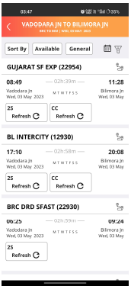
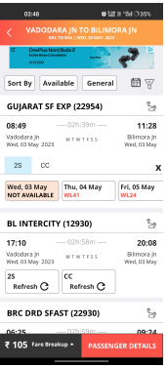
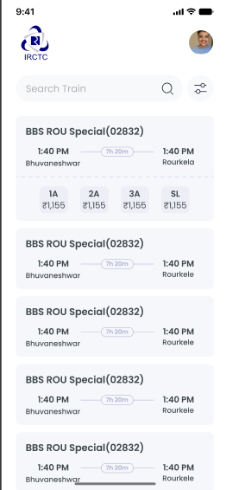
Train List
Original Application
Redesigned Prototype

Slide 36
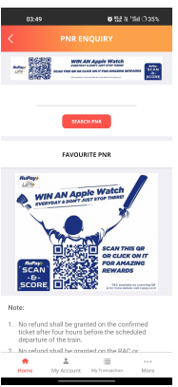
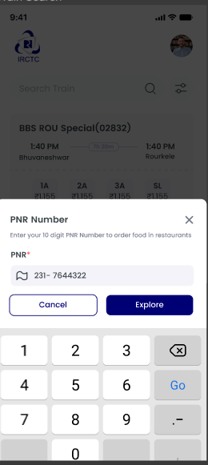
Passenger Name Record(PNR) check
Original Application
Redesigned Prototype

Slide 37
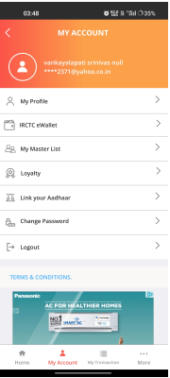
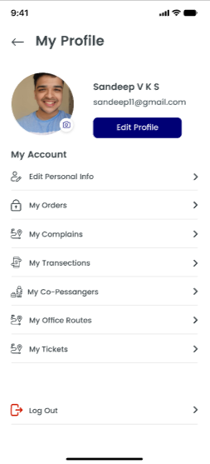
Personal Account Details
Original Application
Redesigned Prototype

Slide 38
Results of IRCTC prototype

Slide 39
Online survey
Age

Slide 40
Gender

Slide 41
Frequency of Travel

Slide 42
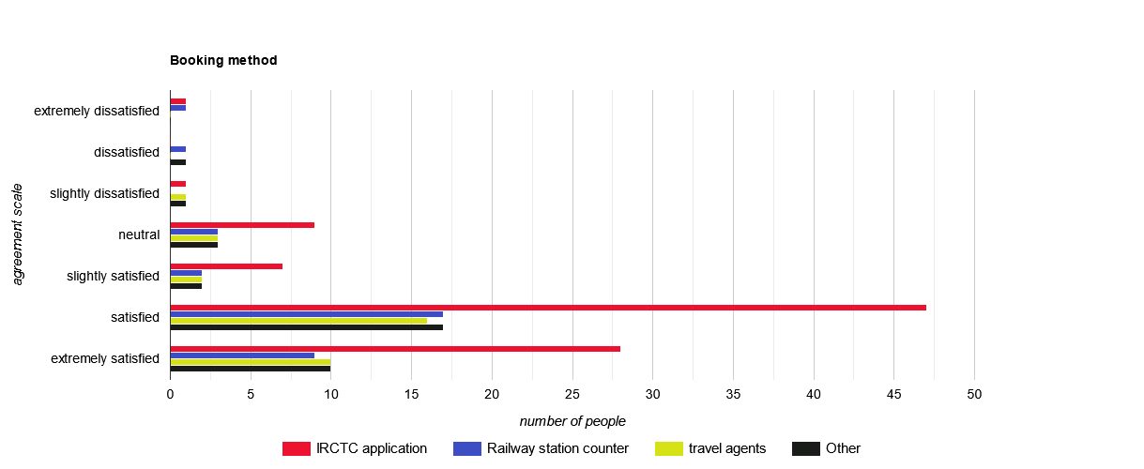
Mode of booking

Slide 43
Three Usability mechanisms

Slide 44
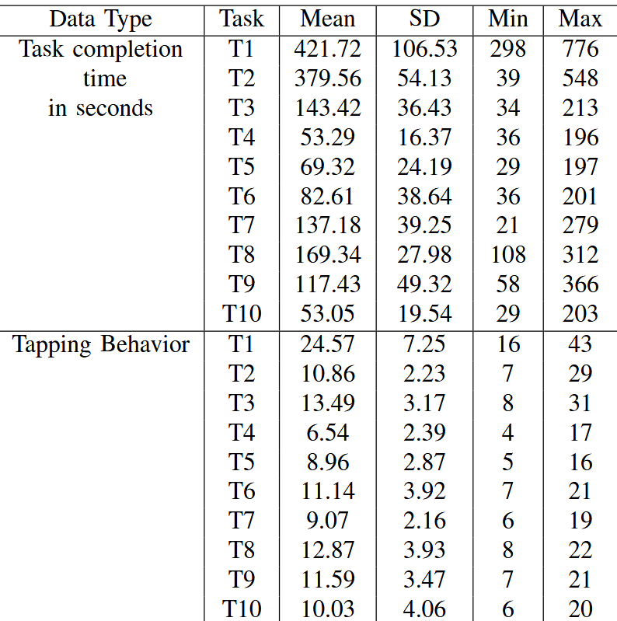
Efficiency

Slide 45
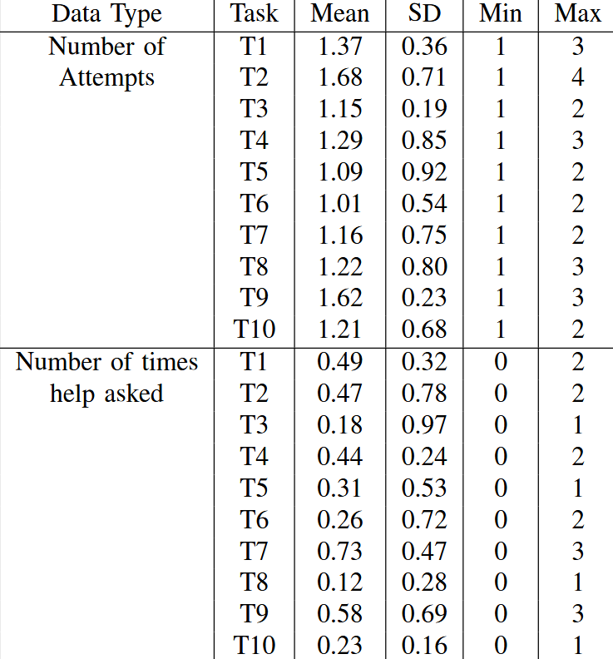
Effectiveness

Slide 46
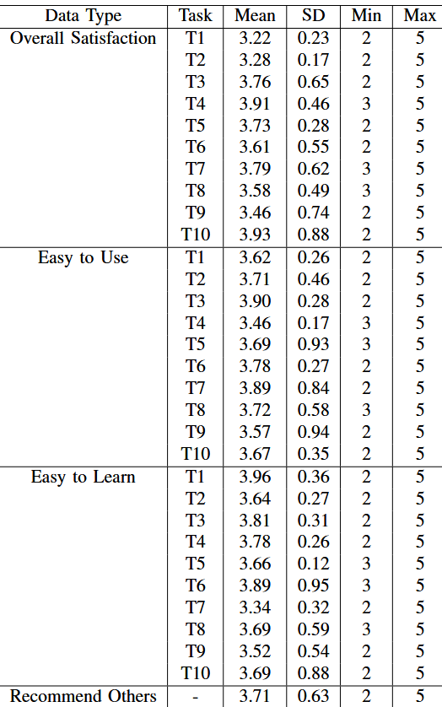
Satisfaction

Slide 47
Comparison of results obtained in surveys (IRCTC application and Prototype)

Slide 48
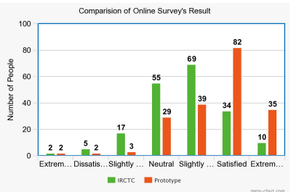
Overall Comparison of the IRCTC
Application vs Prototype

Slide 49
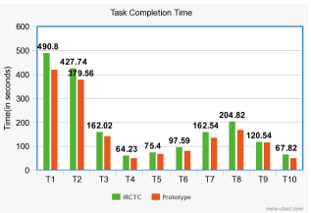
Time taken to complete the tasks

Slide 50
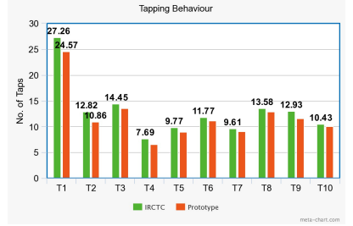
Tapping Behaviour while
Performing the tasks.

Slide 51
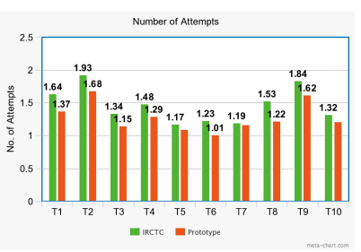
Number of attempts required to
Complete the tasks.

Slide 52
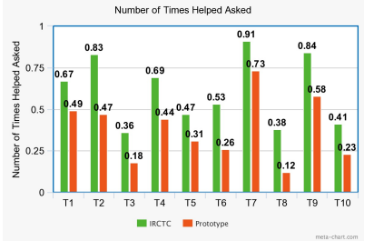
Number of times asked
For help.

Slide 53
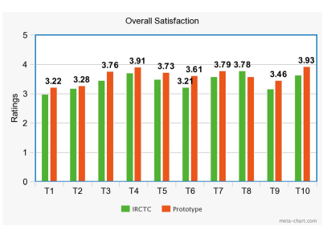
Overall Satisfaction of the User.

Slide 54
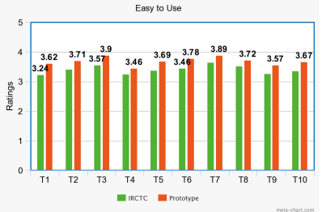
Ease to Use.

Slide 55

Easy to Learn.

Slide 56
Learning-
The surveys really took a lot of effort as the offline surveys were tedious. This paper helped us to understand how to take surveys and the factors which need to be considered while designing the UI of any application
The repetitive and exhaustive method of making a better UI has familiarized us with FIGMA software.
Communication skills drastically increased as the surveys required constant interaction with the users of the application.
This Project helped us to work as a team and it helped us to adapt, analyse and work on the issues.

Slide 57
My Contribution-
I was responsible for designing the online and offline surveys that will be used to collect data from IRCTC users.
Made questions that provided useful insights into how users currently use the application and what changes they would like to see in the UI.
Collectively created a redesigned wireframe for the IRCTC application with Aditya
Teammates Contribution-
Aditya Arya, 201901472 was responsible for analyzing the data collected from the surveys and using it to recommend a new UI design for the IRCTC application.
He carefully reviewed the survey data, looking for trends and patterns that could inform UI design decisions
We Collectively created a redesigned wireframe for the IRCTC application with Sandeep.

Slide 58
THANK YOU

